Slide 1
How to Create Generational Wealth by Investing In Real Estate

Slide 2
Introduction
Luxury Lending
Affluent Clients
Commercial Lending
Multi-Tennant
Niche Lending
Private Lending
Construction Financing
Investment Property

Slide 3
HNW Priorities
High net worth clients have 2 main priorities:
1. Ensuring they can maintain their lifestyle into retirement
2. Create Generational Wealth
Both can be achieved by investing in real estate!

Slide 4
Maintain Lifestyle In Retirement

Slide 5
Create Generational Wealth

Slide 6
Stock Market Crashes

Slide 7
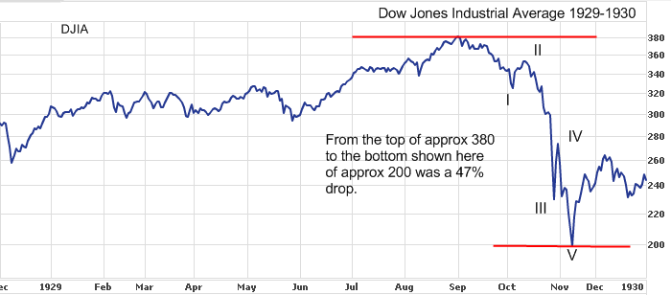
Stock Market Crash - 1929

Slide 8
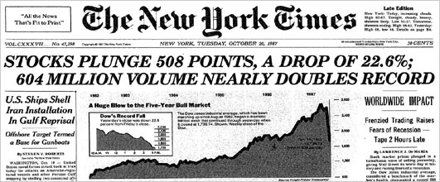
Black Monday - 1987

Slide 9
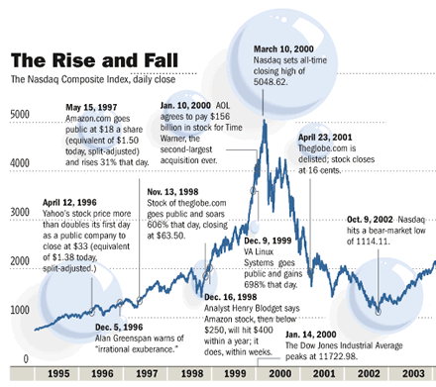
Dotcom Bubble – 1998 to 2002

Slide 10
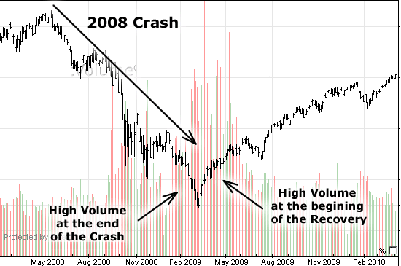
Global Financial Crisis - 2008

Slide 11
Don’t Put All Eggs In 1 Basket!!

Slide 12
Investing In Real Estate
“Ninety percent of all millionaires become so through owning real estate”
- Andrew Carnegie,
$300+ Billion Net Worth

Slide 13
Investing In Real Estate
Investing in real estate is the most powerful way to create wealth in the world:
1. You’re using other people’s money
2. Long term future appreciation of real estate
3. Tax-efficient cash-flow
4. Interest rates are historically low
5. Future capital creation

Slide 14
Investing In Real Estate
Rental Property Purchase:
$2.5M principal residence
$500,000 purchase price on rental
$125,000 mortgage on principal residence
$375,000 mortgage on rental property

Slide 15
Investing In Real Estate
Monthly Income | Monthly Expenses
$4200 rental income | $2400 mortgage
 | $350 property taxes
 | $200 insurance
 | $250 property manager
 | $150 maintenance
$4200 INCOME | $3350 EXPENSES

Slide 16
Investing In Real Estate
Summary:
$850/month positive cash-flow
Did not use any of their own money to purchase an appreciating asset

Slide 17
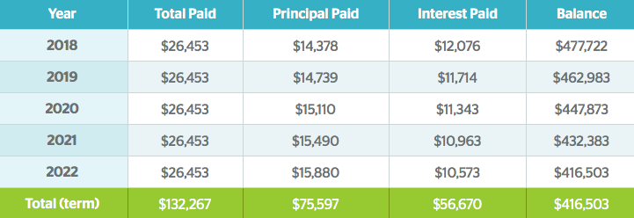
Tenants Pay Your Mortgage

Slide 18
Positive Cash-Flow
$75,000 paid down on mortgage in 5-years
$51,000 net rental income generated in 5-years
$125,000 net worth increase
$0 invested of own capital – 100% financed

Slide 19
Refinance To Purchase More
Mortgage balance is going down
Home value is going up (long term)
Can refinance to purchase other rental properties

Slide 20
Building An Empire

Slide 21
Building An Empire
$500,000 McMaster is now worth $625,000
$75,000 principal paid on the mortgage.
$325,000 owing
80% refinance
$175,000 capital used to purchase another rental property for $625,000

Slide 22
Building An Empire
5-years time:
Investment portfolio has increased to $1.3M ($625K + $625K)
$20,400 in net rental income

Slide 23
Investing In Real Estate
Investing in real estate is the most powerful way to create wealth in the world:
1. You’re using other people’s money
2. Long term future appreciation of real estate
3. Tax-efficient cash-flow
4. Interest rates are historically low
5. Future capital creation

Slide 24
Investing In Real Estate
$45M Shopping Plaza
Strong Anchor Tenants
Long-Term Leases
$2.6M Net Operating Income
$28M Commercial Loan Approved

Slide 25
Investing In Real Estate
Investing in real estate is the most powerful way to create wealth in the world:
1. You’re using other people’s money
2. Long term future appreciation of real estate
3. Tax-efficient cash-flow
4. Interest rates are historically low
5. Future capital creation

Slide 26
Investing In Real Estate
We specialize in financing the following types of properties:
Student rentals
Single Family Residential
Multi-tenant / Apartment Buildings
Commercial
Office
Industrial
Luxury Homes

Slide 27
Investing In Real Estate
Thank-You!
Any Questions?

